Slide 1
OBJECT ORIENTED PROGRAMMING
UNIT-1
Subject Code: 23CSE111
L-T-P-C (Lecture, Tutorial, Practical, and Credit) : 3-0-2-4
By
Dr. Raj Kumar Batchu

Slide 2
Books to Follow
Textbook(s)
Y.Daniel Liang, “Introduction to Java Programming”, Tenth Edition, PHI, 2013.
Grady Booch and Robert A. Maksimchuk, “Object-oriented Analysis and Design with Applications”, Third Edition, Pearson Education, 2009.
Reference(s)
Naughton P. and Schildt H., “Java2 Complete Reference”, Eighth Edition, Tata McGraw- Hill, 2011.
Ali Bahrami, “Object Oriented Systems Development”, Second Edition, McGraw-Hill,2008.
Jaime Nino, Fredrick A Hosch, “An Introduction to Programming and Object Oriented Design using Java”, Wiley India Private Limited, 2010.

Slide 3
Evaluation Pattern
Assessment | Internal | External
Mid Term | 20
*Continuous Assessment (Theory) (CAT) | 10
Continuous Assessment (Lab) (CAL) | 40
End Semester |  | 30
*CA – Can be Quizzes, Assignment, Projects, and Reports

Slide 4
Course Outcomes
CO1: Understand Object Oriented paradigm and represent the problem using objects and classes.
CO2: Apply the Object Oriented concepts to design and develop effective models using UML.
CO3: Develop program logic in Java from design models in UML.
CO4: Design applications with procedural and data abstraction using Java libraries.

Slide 5
23CSE111 - OOP Lab Manual dates for II CSE A,B,C Sections
S.No | Week | Sec A Dates | Sec B Dates | Sec C Dates
1 | 1
2 | 2
3 | 3
4 | 4
5 | 5
6 | 6
7 | 7
8 | 8
9 | 9

Slide 6
Syllabus
Unit 1:
Structured to Object Oriented Approach by Examples - Object Oriented languages - Properties of Object Oriented system – UML and Object Oriented Software Development - Use case diagrams and documents as a functional model - Identifying Objects and classes - Representation of Objects and its state by Object Diagram - Simple Class using class diagram – Encapsulation - Data Hiding - Reading and Writing Objects - Class Level and Instance Level Attributes and Methods- JIVE environment for debugging.

Slide 7
Object-Oriented Paradigm
The Object-Oriented Paradigm is a programming paradigm that uses objects and classes as the fundamental building blocks for designing and organizing software systems.
It focuses on modeling real-world entities, their attributes, and their interactions to create modular, reusable, and maintainable code.
In the context of Object-Oriented Programming (OOP), a paradigm refers to a fundamental and overarching approach for designing and structuring software systems. It encompasses a set of principles, concepts, and practices that guide how you model, organize, and interact with entities in your code.

Slide 8
Structured to Object Oriented Approach by Examples
The structured programming approach focuses on breaking down a problem into smaller, manageable components called functions or procedures.
These functions operate on data using control structures like loops and conditionals.
However, as systems grow in complexity, structured programming (Pascal, ALGOL, C, Modula-2, etc) can lead to difficulties in managing the codebase, especially when changes are needed.

Slide 9
Object-Oriented Programming, is a different approach to programming that brings together data and functions that execute on them.
It basically supports encapsulation, abstraction, inheritance, polymorphism, etc.
It also includes data hiding feature therefore it is more secure.
It performs well in situation where systems are undergoing continuous design, adaption, and maintenance.
Ex: Java, C++, C#, Python, Simula (First OO), Smalltalk (First pure OO).
The OO model is beneficial in the following ways −
It facilitates changes in the system at low cost.
It promotes the reuse of components.
It simplifies the problem of integrating components to configure large system.
It simplifies the design of distributed systems.

Slide 10
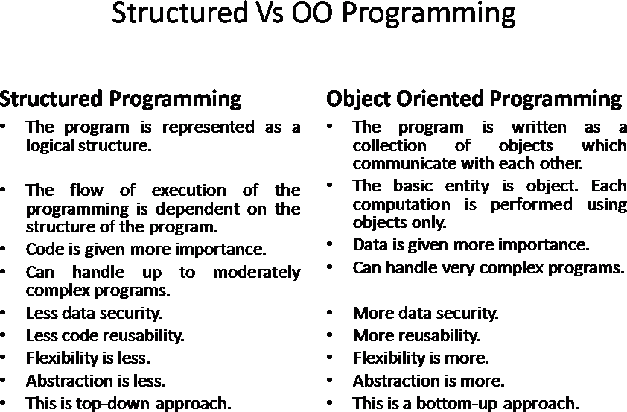

Slide 11
Object-Oriented Analysis and Design (OOAD) Approach
Object-Oriented Analysis and Design (OOAD) is a methodology for designing and modeling software systems using object-oriented concepts.
In OOAD, you not only focus on coding but also on the overall system design, requirements analysis, and architecture.
The transition from a structured approach to OOAD involves identifying objects, their attributes, methods, interactions, and the overall structure of the system.
This analysis lays the foundation for a well-organized and maintainable codebase.

Slide 12
Object-Oriented Approach
The object-oriented programming (OOP) approach aims to organize code around the concept of objects, which are instances of classes.
Each class defines both data (attributes) and behaviors (methods) that are related to a specific concept.
This approach promotes encapsulation, inheritance, and polymorphism, leading to more modular and maintainable code.

Slide 13
Object Oriented Languages
Object-oriented programming (OOP) languages are programming languages that are based on the concepts of objects, which encapsulate data and behavior. Here are some of the most common object-oriented programming languages:
Java: A general-purpose, high-level programming language that is designed to have as few implementation dependencies as possible. Java is known for its "write once, run anywhere" approach, where code written for Java can run on any device that supports Java without the need for recompilation.
C++: An extension of the C programming language that adds support for object-oriented programming. C++ is known for its performance and efficiency, as well as its ability to be used for both high-level and low-level programming.
C#: A general-purpose, multi-paradigm programming language developed by Microsoft. C# is designed for use in developing software components suitable for deployment in distributed environments.

Slide 14
Python: A high-level, interpreted programming language known for its simplicity and readability. Python supports multiple programming paradigms, including object-oriented, imperative, functional, and procedural.
Ruby: An object-oriented programming language known for its simplicity and flexibility. Ruby is often used in web development due to its web application framework, Ruby on Rails.
Swift: A general-purpose, compiled programming language developed by Apple for use in developing applications for Apple's platforms, including macOS, iOS, watchOS, and tvOS.
Objective-C: A general-purpose, object-oriented programming language that is a superset of the C programming language. Objective-C is used primarily by Apple for macOS and iOS application development.

Slide 15
Useful Links:
1.Object-Oriented Programming (OOP) Concepts 2.Object-Oriented Analysis and Design (OOAD) 3.Introduction to Object-Oriented Programming 4.Object-Oriented Analysis and Design Concepts
5.Structured Programming vs. Object-Oriented Programming

Slide 16
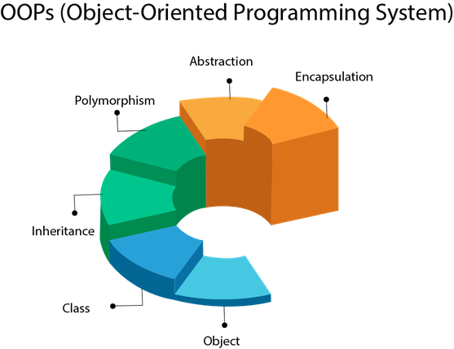
Properties of Object Oriented system
Object
Class
Inheritance
Polymorphism
Data Abstraction
Encapsulation
Modularity
Dynamic Binding
Message Passing
Data Hiding

Slide 17
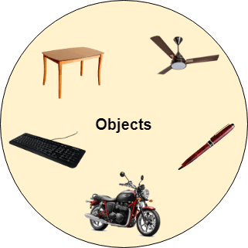
Object
Any entity that has state and behavior is known as an object.
Example: a chair, pen, table, keyboard, bike, etc.
It can be physical or logical.
An Object can be defined as an instance of a class. An object contains an address and takes up some space in memory.
Example: A dog is an object because it has states like color, name, breed, etc. as well as behaviors like wagging the tail, barking, eating, etc.
Class
Collection of objects is called class. It is a logical entity.
A class can also be defined as a blueprint from which you can create an individual object. Class doesn't consume any space.

Slide 18
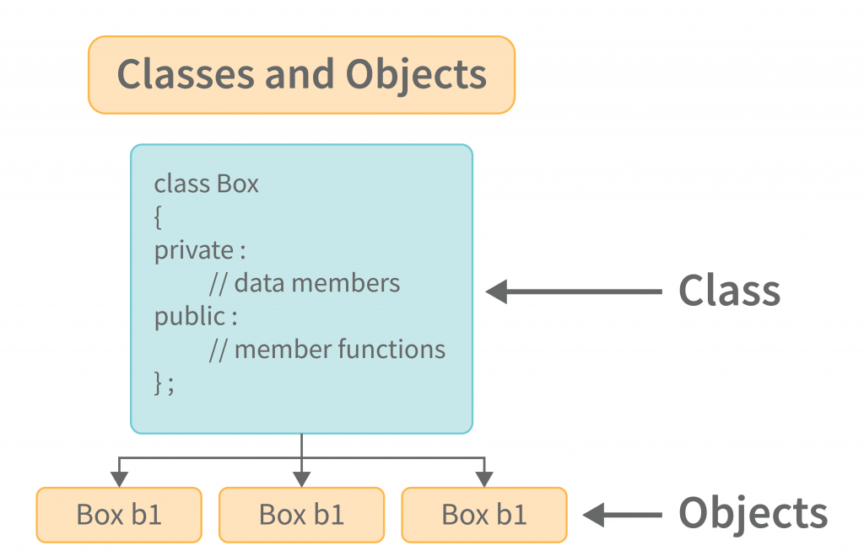

Slide 19
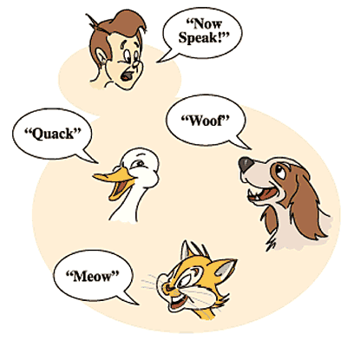
Inheritance
When one object acquires all the properties and behaviors of a parent object, it is known as inheritance. It provides code reusability. It is used to achieve runtime polymorphism.
Polymorphism
If one task is performed in different ways, it is known as polymorphism.
For example: to convince the customer differently, to draw something, for example, shape, triangle, rectangle, etc.
In Java, we use method overloading and method overriding to achieve polymorphism.
Another example can be to speak something; for example, a cat speaks meow, dog barks, woof, etc.
A person at the same time can have different characteristics. Like a man at the same time is a father, a husband, an employee. So the same person posses different behavior in different situations. This is called polymorphism.

Slide 20
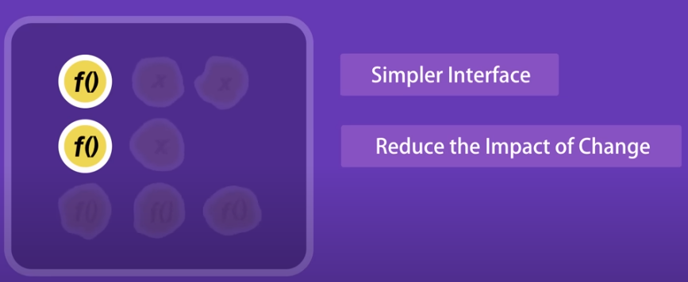
Abstraction
Hiding internal details and showing functionality is known as abstraction.
(or)
It refers to providing only essential information about the data to the outside world, hiding the background details or implementation.
For example
phone call - we don't know the internal processing.
Man driving a car - The man only knows that pressing the accelerators will increase the speed of the car or applying brakes will stop the car, but he does not know about how on pressing the accelerator the speed is increasing, he does not know about the inner mechanism of the car or the implementation of the accelerator, brakes, etc in the car.

Slide 21
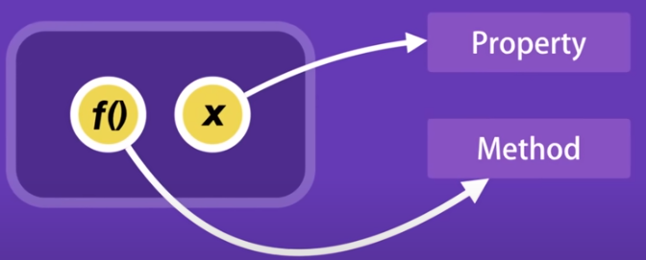
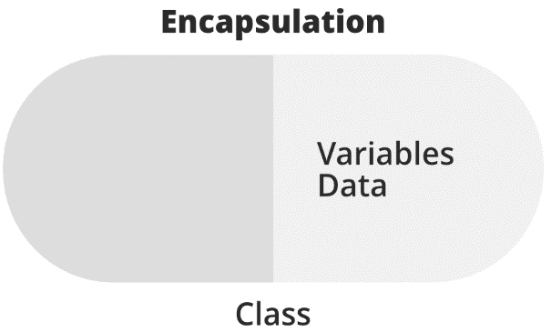
Encapsulation
Binding (or wrapping) code and data together into a single unit are known as encapsulation. For example, a capsule, it is wrapped with different medicines.
In Encapsulation, the variables or data of a class are hidden from any other class and can be accessed only through any member function (method) of their class in which they are declared.
As in encapsulation, the data in a class is hidden from other classes, so it is also known as data-hiding.

Slide 22
Example - In a company, there are different sections like the accounts section, finance section, sales section, etc.
The finance section handles all the financial transactions and keeps records of all the data related to finance. Similarly, the sales section handles all the sales-related activities and keeps records of all the sales.
Now there may arise a situation when for some reason an official from the finance section needs all the data about sales in a particular month. In this case, he is not allowed to directly access the data of the sales section.
He will first have to contact some other officer in the sales section and then request him to give the particular data. This is what encapsulation is. Here the data of the sales section and the employees that can manipulate them are wrapped under a single name “sales section”.

Slide 23
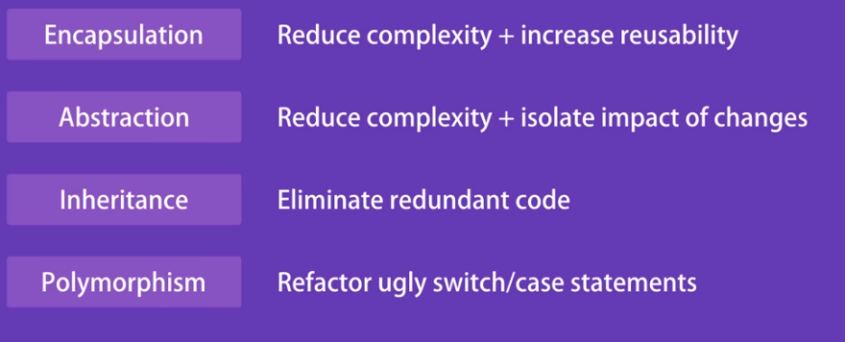
Benefits

Slide 24
Modularity: Modularity is the process of dividing a system into smaller, more manageable parts, known as modules. This allows for better organization and reusability of code.
Dynamic Binding: Dynamic binding is the process of linking a method call to its corresponding implementation at runtime. This allows for more flexibility in the behavior of objects.
Message Passing: Message passing is the mechanism by which objects communicate with each other. This is typically achieved through the use of method calls.
Data Hiding: Data hiding is the process of restricting access to certain data within an object, allowing for better control over the use and modification of data.

Slide 25
UML Diagrams
https://www.visual-paradigm.com/guide/uml-unified-modeling-language
https://www.lucidchart.com

Slide 26
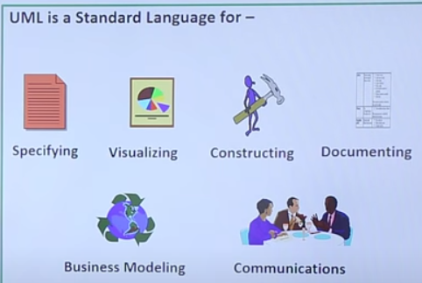
What is UML?
UML stands for Unified Modelling Language.
It is a industry-standard graphical language for specifying, visualizing, constructing, and documenting the artifacts of software systems, business modeling and other non-software systems.
The UML represents a collection of best engineering practices that have proven successful in the modeling of large and complex systems.
It uses mostly graphical notations to express the analysis and design of software projects.
It helps project teams communicate, explore potential designs, and validate the architectural design of the software.
It is not dependent on any one language or technology.

Slide 27
Goal of UML?
A picture is worth a 1000 words.
It defines some general purpose modelling language, which all modellers can use and it also needs to be made simple to understand and use.
UML diagrams are not only made for developers but also for business users, common people, and anybody interested to understand the system.
It is not a development method rather it accompanies with processes to make it a successful system.

Slide 28



Overview of UML Diagrams
Behavioral
: behavioral features of a system / business process
Structural
: element of spec. irrespective of time
Class
Component
Deployment
Object
Composite structure
Package
Activity
State machine
Use case
Interaction
Interaction
: emphasize object interaction
Communication(collaberati
on)
Sequence
Interaction overview
Timing

Slide 29
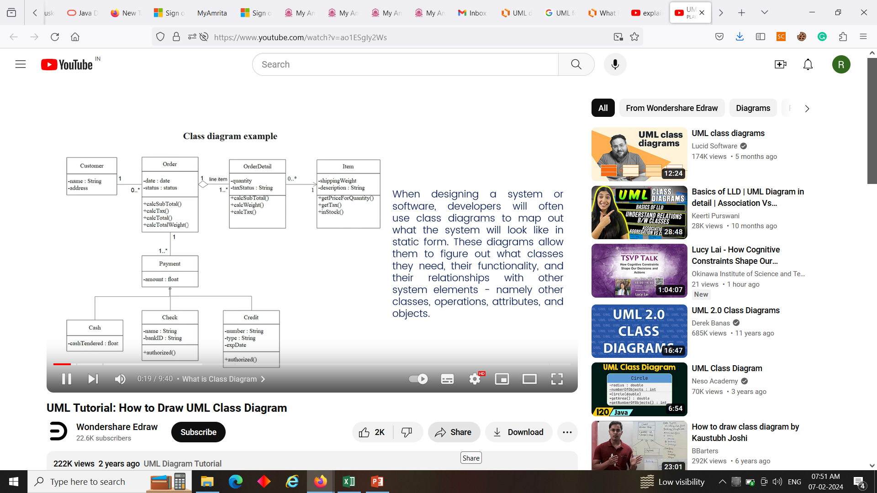
Class diagram
UML class diagrams show the classes of the system, their inter- relationships, and the operations and attributes of the classes
Explore domain concepts in the form of a domain model.
Analyze requirements in the form of a conceptual/analysis model.
Depict the detailed design of object-oriented or object-based software.

Slide 30
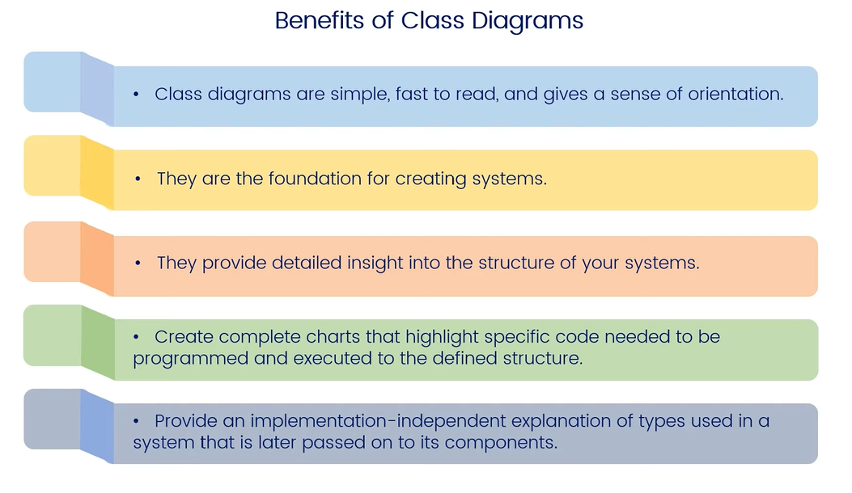

Slide 31
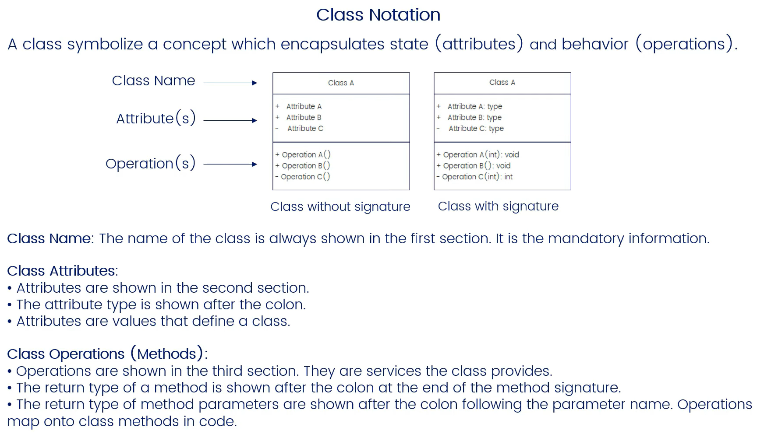
Class representation in UML

Slide 32
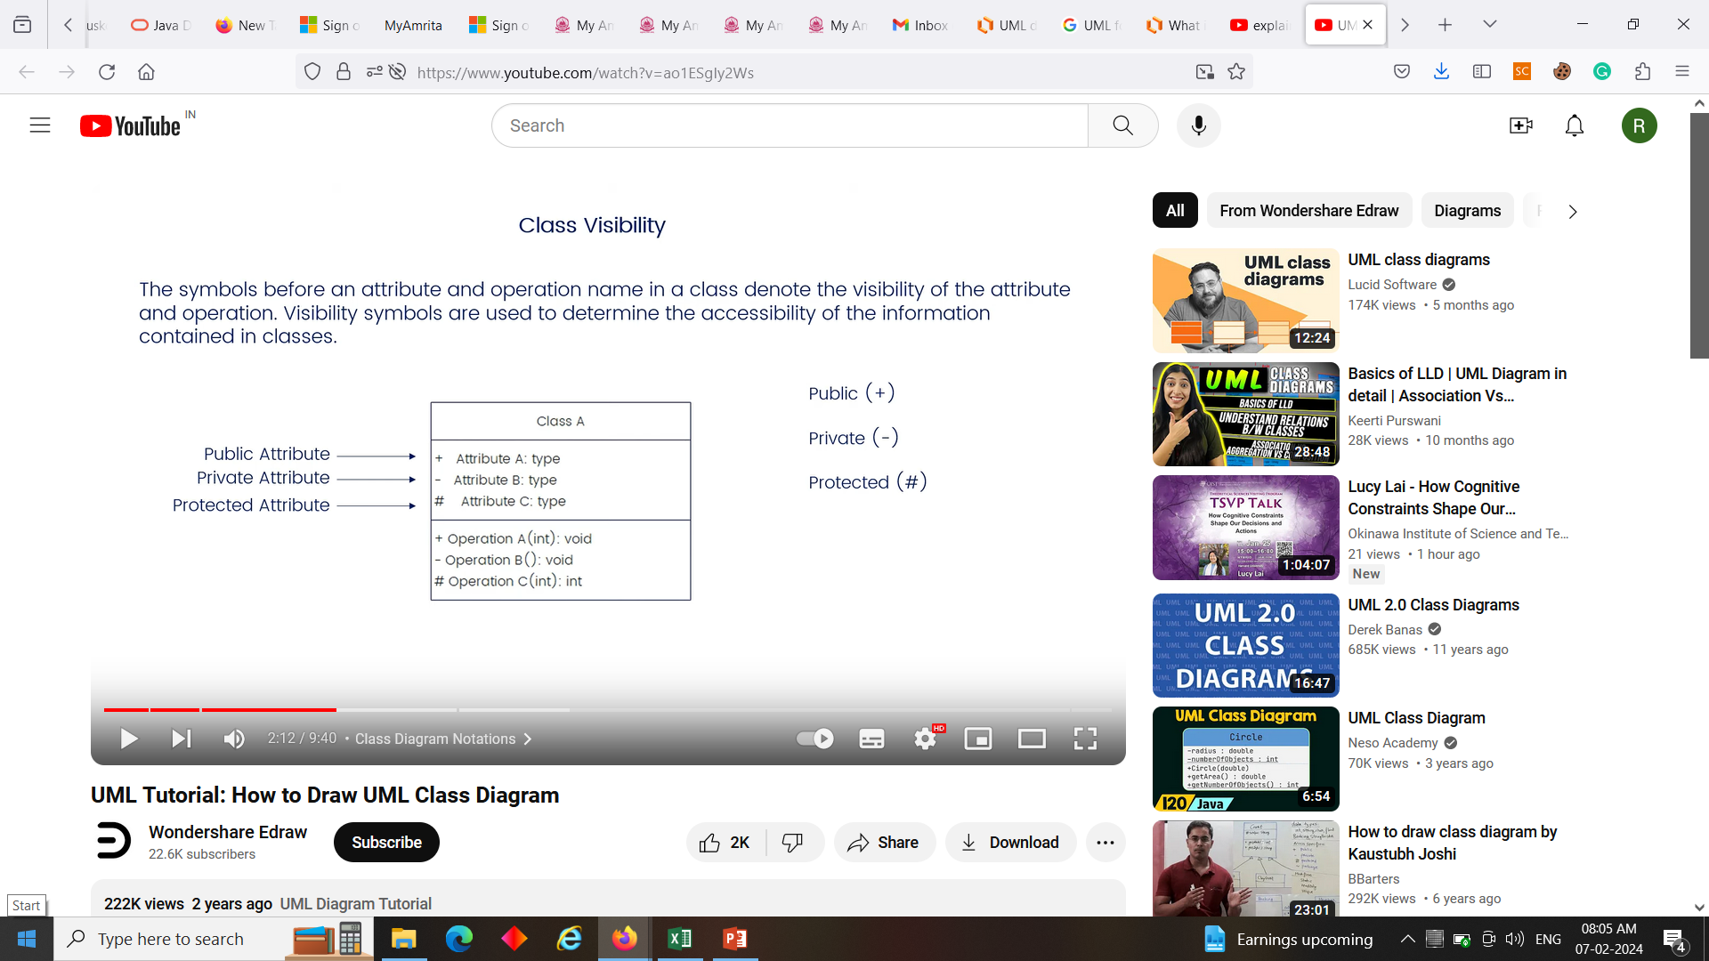
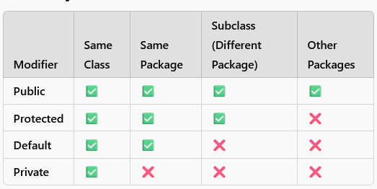

Slide 33
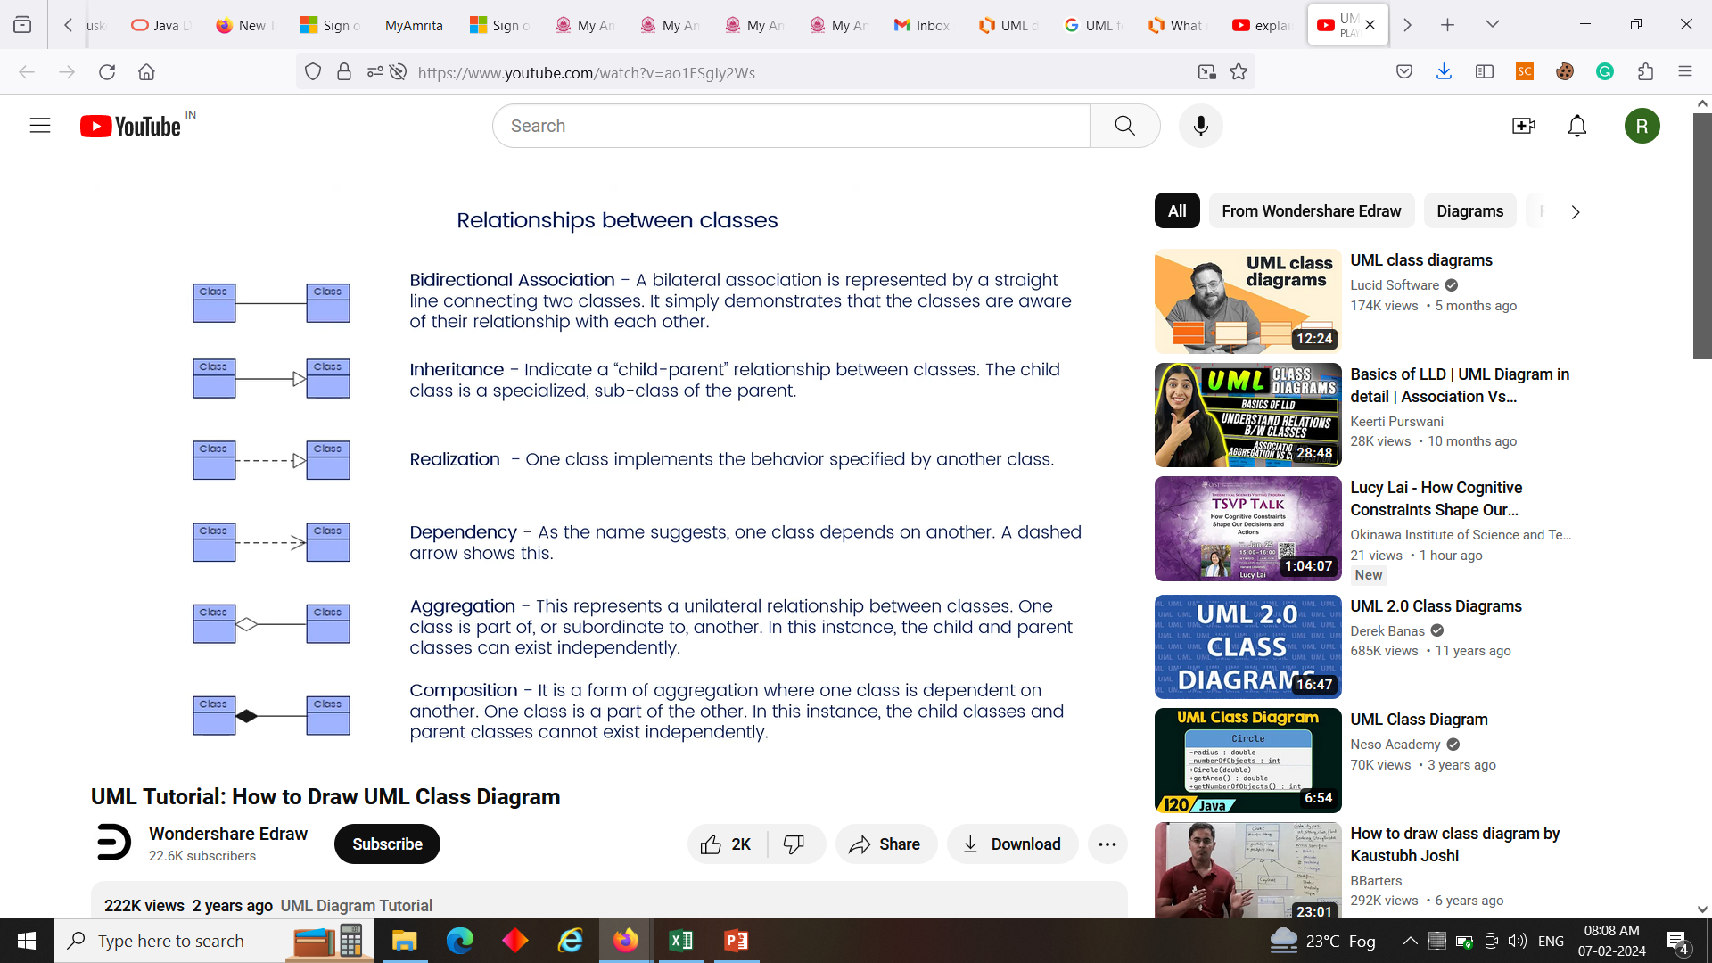
Inheritance / Generalization

Slide 34
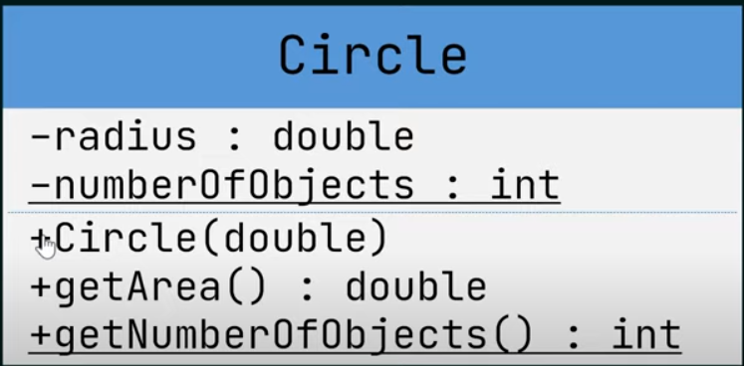
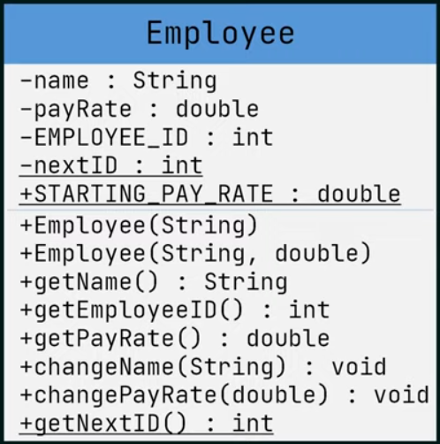
Class representation in UML
Underline - static attribute/method
+,-,# - access specifiers
Method with same name as class – constructor
Italic – abstract class

Slide 35
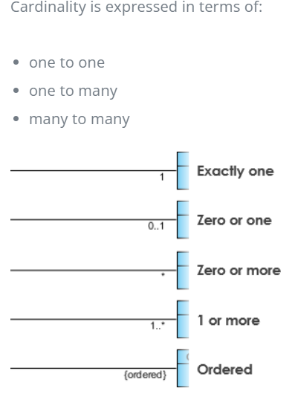
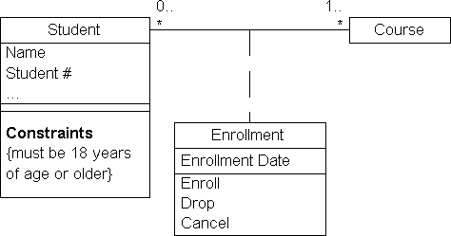
Class diagram Example

Slide 36
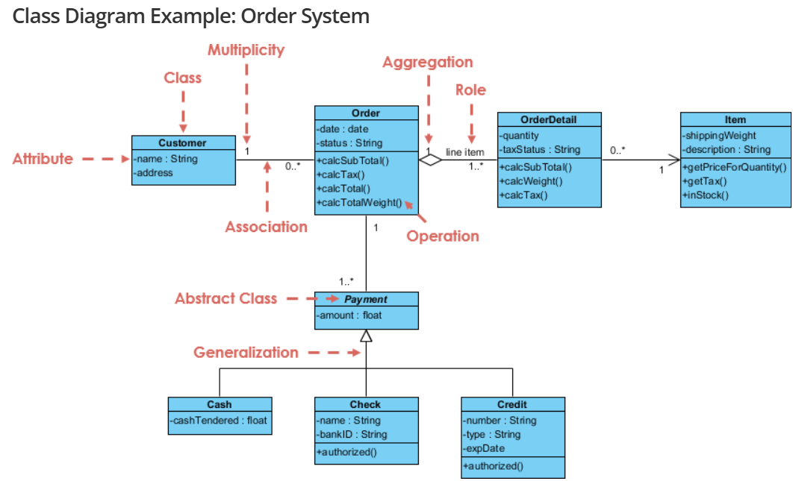
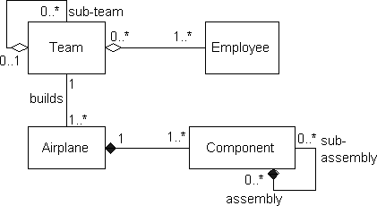

Slide 37
Component diagram
A component diagram is used to break down a large object-oriented system into the smaller components, so as to make them more manageable.
It visualizes the relationships as well as the organization between the components present in the system. It helps in forming an executable system.
The term "component" refers to a module of classes that represent independent systems or subsystems, which can interact with other parts of the system.
In this approach, component diagrams help planners recognize system components, ensuring everything functions as expected.
In object-oriented programming, a component diagram helps a senior developer organize related classes by their purpose, providing a high-level overview of the software project.

Slide 38
A single component diagram cannot represent the entire system but a collection of diagrams is used to represent the whole.
Each component is responsible for one clear goal within the entire system.
It is like a black box whose behavior is explained by the provided and required interfaces.
Benefits of component diagrams
These are invaluable while building your system. Component diagrams can help your team:
Imagine the system’s physical structure.
Pay attention to the system’s components and how they relate.
Emphasize the service behavior as it relates to the interface.

Slide 39
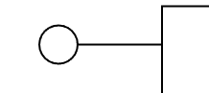
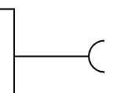

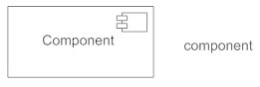

 | Provided interfaces: A straight line from the component box with an attached circle. These symbols represent the interfaces where a component produces information used by the required interface of another component.
 | Required interfaces: A straight line from the component box with an attached half circle. These symbols represent the interfaces where a component requires information in order to perform its proper function.
 | Dependency: Shows that one part of your system depends on another. Dependencies are represented by dashed lines linking one component (or element) to another.
 | Component: A component provides and consumes behavior through interfaces, as well as through other components. Think of components as a type of class.
 | Port Symbol: Ports are represented using a square along the edge of the system or a component. A port is often used to help expose required and provided interfaces of a component.

Slide 40
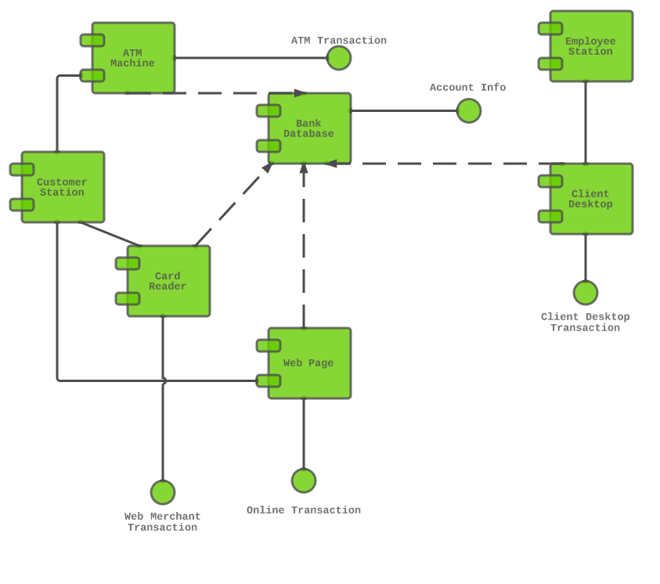
In the diagram below, each component is enclosed in a small box.
The dotted lines with arrows show how some components are dependent on others.
For example, the card reader, web page, client desktop, and ATM system are all dependent on the bank database.
The dotted lines with circles at the end, known as “lollipop” symbols, indicate a realization relationship.
Example: Component diagram for an ATM system

Slide 41
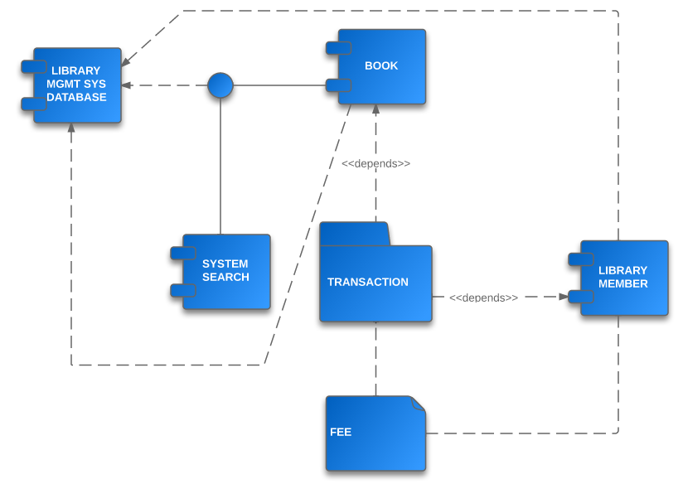
Example: Component diagram for a library management system

Slide 42
Example: Component Diagram for an Online Order System
A typical Online Order System might include the following components:
User Interface (UI): Manages user interactions.
Order Processing Service: Handles order placement and validation.
Payment Gateway: Manages transactions.
Inventory Management: Updates stock levels.
Database: Stores customer, product, and order information.
Example relationships:
The UI Component communicates with the Order Processing Component.
The Order Processing Component interacts with the Payment Gateway and Inventory Management.
The Database Component stores order details, customer data, and product inventory.

Slide 43
Deployment diagram
UML deployment diagram depicts a static view of the run-time configuration of hardware nodes and the software components that run on those nodes.
Deployment diagrams show the hardware for your system, the software that is installed on that hardware, and the middleware used to connect the disparate machines to one another.
You can use Deployment diagrams to:
Show which software elements are deployed by which hardware elements.
Illustrate the runtime processing for hardware.
Provide a view of the hardware system’s topology.

Slide 44
When to use a Deployment Diagram?
The deployment diagram is mostly employed by network engineers, system administrators, etc. with the purpose of representing the deployment of software on the hardware system.
It envisions the interaction of the software with the hardware to accomplish the execution. The selected hardware must be of good quality so that the software can work more efficiently at a faster rate by producing accurate results in no time.
The software applications are quite complex these days, as they are standalone, distributed, web-based, etc. So, it is very necessary to design efficient software.

Slide 45
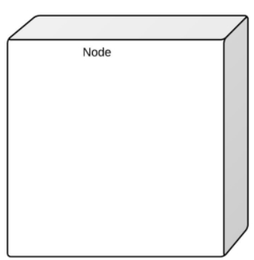
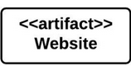
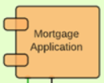
 | Node: A hardware or software object, shown by a three-dimensional box.
 | Artifact: A product developed by the software, symbolized by a rectangle with the name and the word “artifact” enclosed by double arrows.
 | Component: A rectangle with two tabs that indicates a software element.
 | Association: A line that indicates a message or other type of communication between nodes.
 | Package: A file-shaped box that groups together all the device nodes to encapsulate the entire deployment.
 | Node as container: A node that contains another node inside of it—such as in the example, where the nodes contain components.
 | Stereotype: A device contained within the node, presented at the top of the node, with the name bracketed by double arrows << >>.

Slide 46
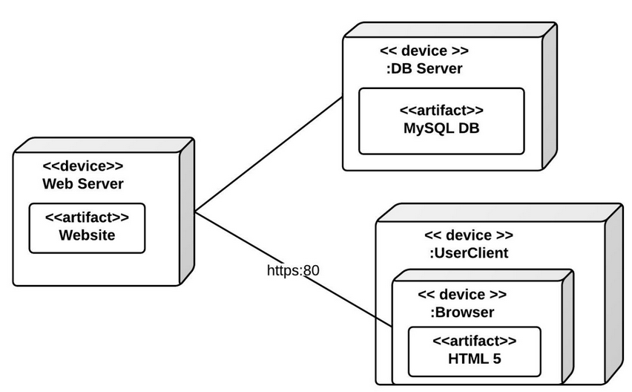
Deployment diagram Example
This example shows a basic deployment diagram. There is a web server, a database server, and the machine where the user views the website.

Slide 47
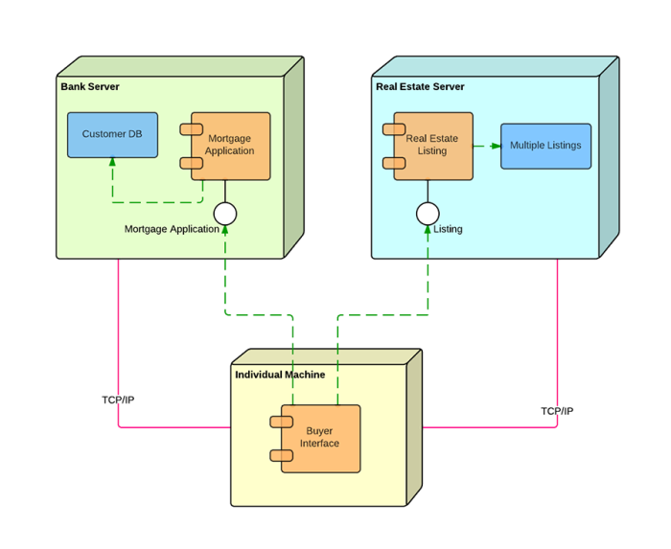
Real estate and mortgage application system
Green Dotted Lines: Indicate the flow of information and requests:
The individual machine connects to both servers to send mortgage applications and retrieve listings.
The Bank Server processes mortgage applications and may send back confirmations or requests for more information.
TCP/IP: This representation at the bottom suggests that the communication between the individual machine and the servers is facilitated over the internet using the TCP/IP protocol.

Slide 48
Object diagram
A UML object diagram represents a specific instance of a class diagram at a certain moment in time.
An object diagram focuses on the attributes of a set of objects and how those objects relate to each other.
It shows instances instead of classes. They are useful for explaining small pieces with complicated relationships, especially recursive relationships.
Purpose of Object Diagram
During the analysis phase of a project, you might create a class diagram to describe the structure of a system and then create a set of object diagrams as test cases to verify the accuracy and completeness of the class diagram.
Before creating a class diagram, you can use an object diagram to identify details about specific model elements and their relationships.

Slide 49
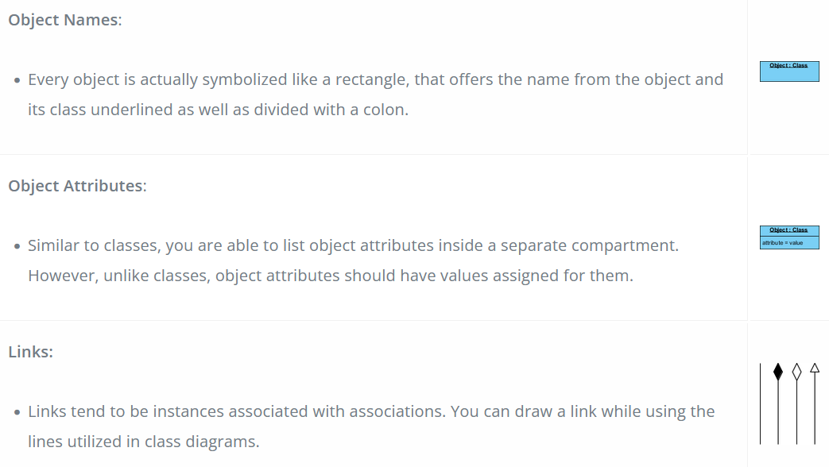
Basic Object Diagram Symbols and Notations

Slide 50
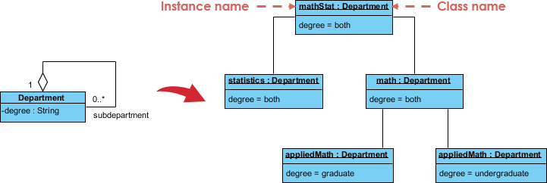
Object diagram
This small class diagram shows that a university Department can contain lots of other Departments and the object diagram below instantiates the class diagram, replacing it by a concrete example.
Class Diagram
Object Diagram

Slide 51
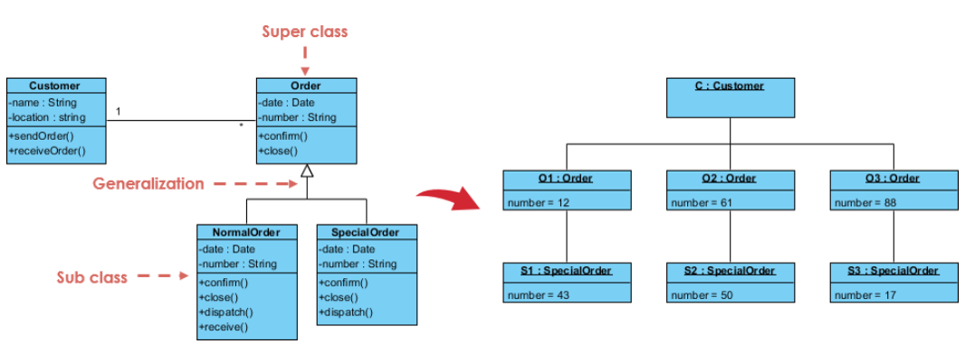
Class to Object Diagram Example - Order System
Generalization: A relationship in which one model element (the child) is based on another model element (the parent).

Slide 52
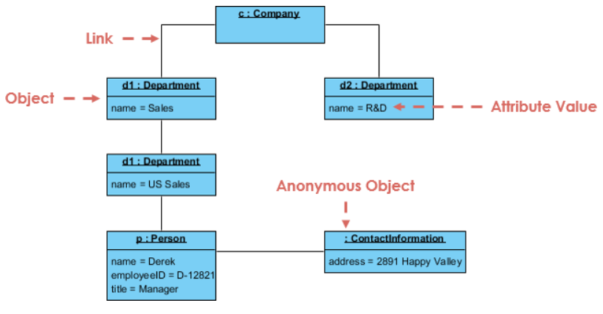
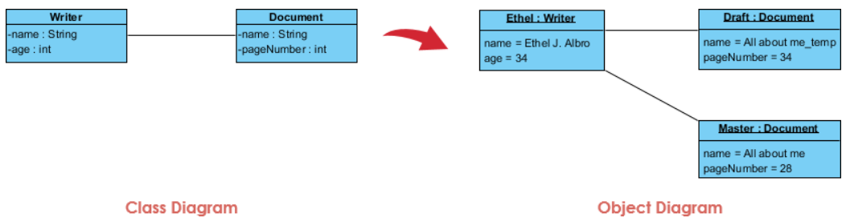
Class diagrams show the actual classifiers and their relationships in a system
Object diagrams show specific instances of those classifiers and the links between those instances at a point in time.
implying that a writer can create documents.

Slide 53
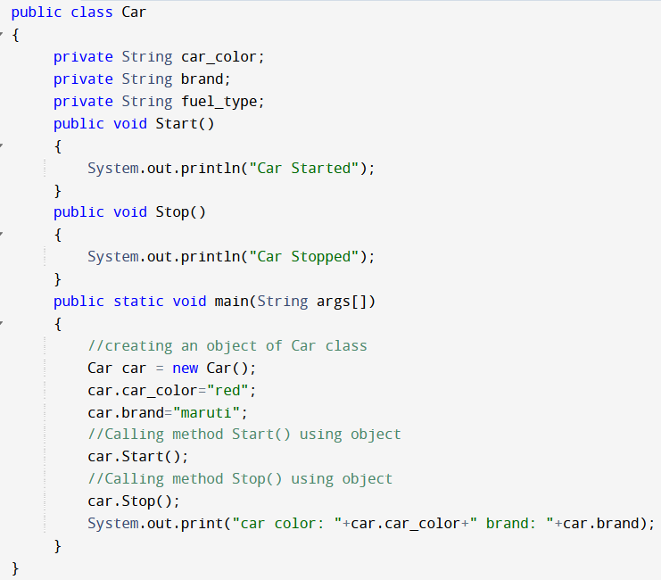
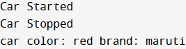
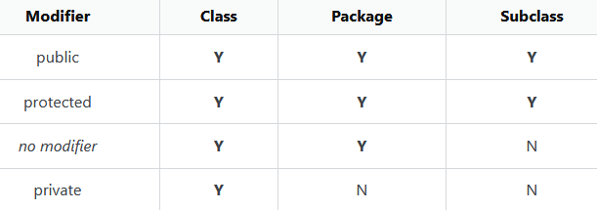
Output:

Slide 54
Identifying Objects and classes - Representation of Objects and its state by Object Diagram
When identifying objects and representing them using object diagrams, you are essentially capturing the structure and behavior of objects within a system. This approach helps to model how objects interact and collaborate to fulfill the functionalities of the system. Here's how to identify objects, represent them with state and behavior, and create object diagrams:
Identifying Objects:
Problem Domain Understanding: Understand the problem domain and the system's requirements to identify
the real-world entities that need to be represented as objects.
Real-World Entities: Identify the main entities, concepts, or things that play a role in the system. These entities will become objects in your model.
Defining State and Behavior:
Attributes (State): For each identified object, determine its attributes (data) that
describe its current state. Attributes are properties that characterize the object.
Methods (Behavior): Define the methods (functions or behaviors) that the object can perform. These methods represent the actions the object can take.

Slide 55
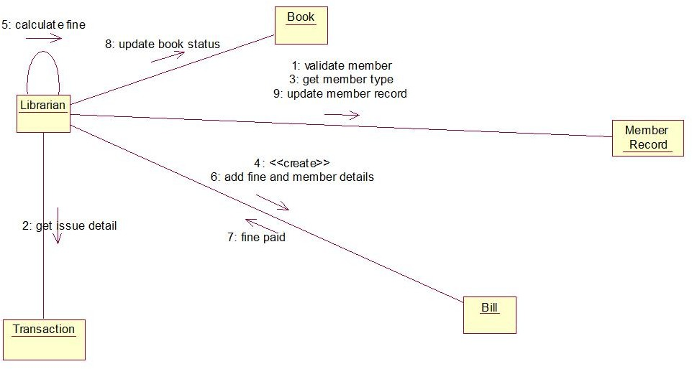
Identify Objects:
Book Member Librarian
Define State and Behavior:
Book:
State (Attributes): Title, Author, ISBN Behavior (Methods): Borrow, Return
Member:
State (Attributes): Name, Member ID
Behavior (Methods): Borrow Book, Return Book
Librarian:
State (Attributes): Name, Employee ID
Behavior (Methods): Manage Inventory, Process Returns

Slide 56
Package diagram
A package is a collection of logically related UML elements. Packages are depicted as file folders and can be used on any of the UML diagrams.
It contains classes, interfaces, and other elements that belong to the same group.
The below is a business model in which the classes are grouped into packages:
Packages appear as rectangles with small tabs at the top.
The package name is on the tab or inside the rectangle.
The dotted arrows are dependencies.
One package depends on another if changes in the other could possibly force changes in the first.

Slide 57
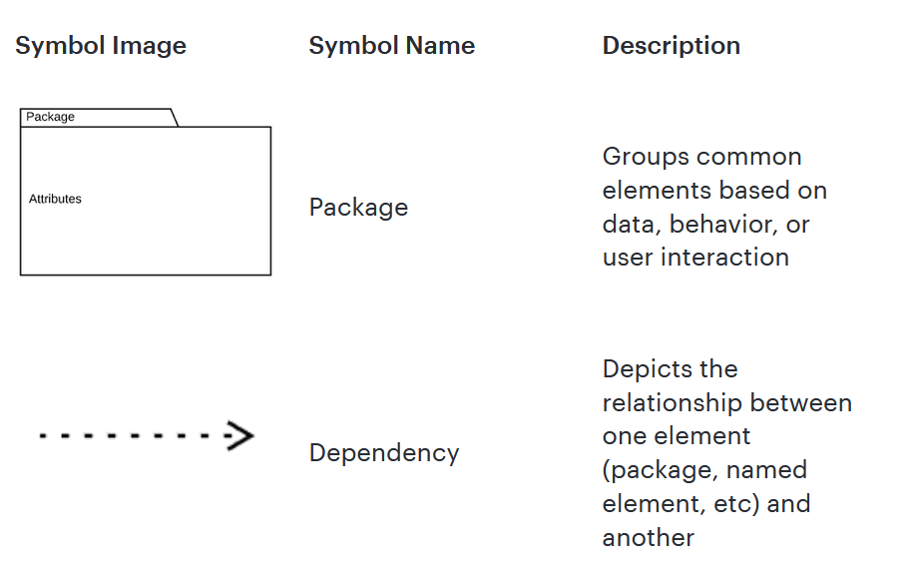
Dependency notations in a package diagram
Package diagrams are used, in part, to depict import and access dependencies between packages, classes, components, and other named elements within your system.
Each dependency is rendered as a connecting line with an arrow representing the type of relationship between the two or more elements.

Slide 58
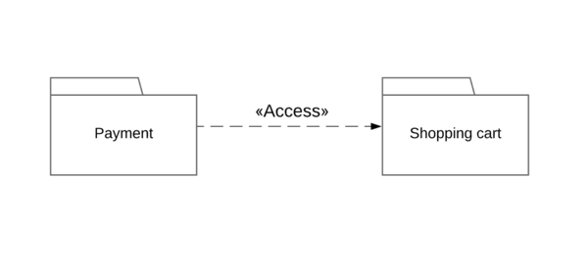
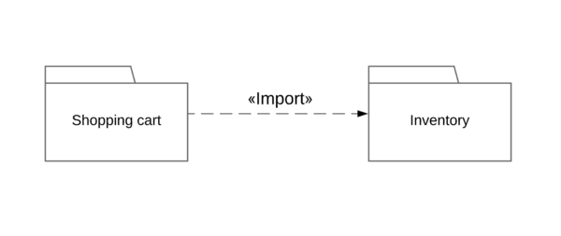
Access: Indicates that one package requires assistance from the functions of another package.
Import: Indicates that functionality has been imported from one package to another.
There are few constraints while using package diagrams, they are as follows.
Package name should not be the same for a system, however classes inside different packages could have the same name.
Packages can include whole diagrams, name of components alone or no components at all.
Fully qualified name of a package has the following syntax.

Slide 59
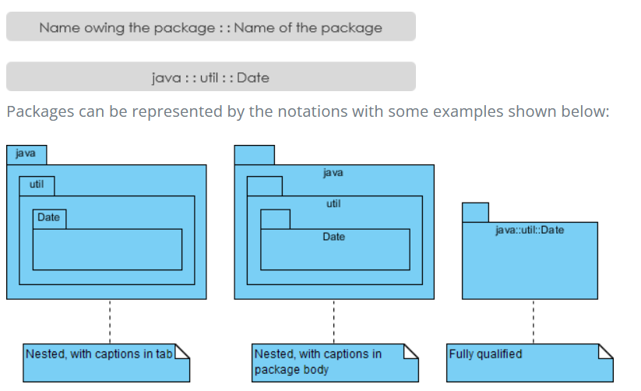

Slide 60
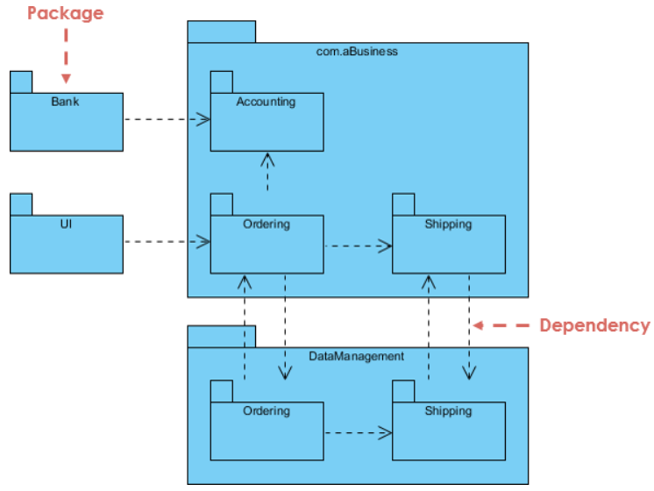
Package Diagram

Slide 61
Behavioral - Activity diagram
Activity diagrams help people on the business and development sides of an organization to understand the same process and behavior.
It represent the flow from one activity to another activity. The activity can be described as an operation of the system.
The flow of an activity can be parallel, branched and concurrent.
Activity diagrams deal with all type of flow control by using different elements such as fork, join, etc.
The main purpose is to capture the dynamic behavior of the system.
The diagram is drawn with the four main activities of order management system −
Send order by the customer
Receipt of the order
Confirm the order
Dispatch the order

Slide 62
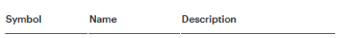
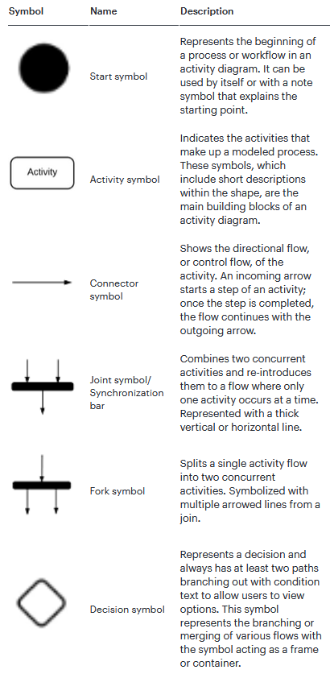
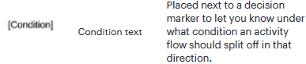
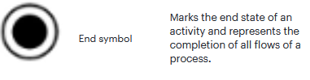

Slide 63

Activity diagram
Activity diagram can be used for –
Modeling work flow by using activities.
Modeling business requirements.
High level understanding of the system's functionalities.
Investigating business requirements at a later stage.

Slide 64

This diagram shows the process of either withdrawing money from or depositing money into a bank account. An advantage of representing the workflow visually in UML is the ability to show withdrawals and deposits on one chart.

Slide 65
State machine diagram
State machine diagrams can show the different states of an object also how an object responds to various events by changing from one state to another.
They define different states of an object during its lifetime and these states are changed by events.
States are defined as a condition in which an object exists and it changes when some event is triggered.
Before drawing a State chart diagram we should clarify the following points ---
Identify the important objects to be analyzed.
Identify the states.
Identify the events.
Key Elements of a State Machine Diagram
States - Represents different conditions an object can be in.
Example: In a Login System, states could be Idle, Entering Credentials, and Authenticated.

Slide 66
Transitions
Shows movement from one state to another due to an event.
Example: Clicking the "Login" button moves from Entering Credentials → Authenticated.
Initial State
The starting point of the system. Represented by a filled black circle (•).
Final State
The end condition of the system. Represented by a black circle with an outer ring.
Events/Triggers
Conditions that cause a transition between states.
Example: User enters a correct password → Moves to "Authenticated" state.
Conditions
Optional conditions that must be met before a transition occurs.
Example: "User enters correct PIN" → Unlocks account.
Composite States
A state that contains sub-states inside it.
Example: A "Processing Order" state might contain "Validating Payment" and "Packaging Items".

Slide 67

State machine diagram for order object
Characteristics of State
State represent the conditions of objects at certain points in time.
Objects (or Systems) can be viewed as moving from state to state

Slide 68

State machine diagram to check in at an airport

Slide 69
Use cases diagram
An Use Case Diagram represents the interaction between actors (users or external systems) and a system under consideration to accomplish specific goals.
It provides a high-level view of the system’s functionality by illustrating the various ways users can interact with it.
Use cases. These are like scenes in the play. They represent specific things your system can do. In the online shopping system, examples of use cases could be “Place Order,” “Track Delivery,” or “Update Product Information”. Use cases are represented by ovals.
Actors. An actor is a person, organization, or external system that uses our system to achieve a goal. Actors are drawn as stick figures.
Associations. Associations between actors and use cases are indicated by solid lines. An association exists whenever an actor is involved with an interaction described by a use case.

Slide 70

System Boundary
The system boundary is a visual representation of the scope or limits of the system you are modeling. It defines what is inside the system and what is outside. Ex: Whatever you’re developing, it can be a website, software component, business process, app, etc.
Purpose of Use Case Diagram
Use case diagrams are typically developed in the early stage of development
Specify the context of a system
Capture the requirements of a system
Validate a systems architecture
Drive implementation and generate test cases
Developed by analysts together with domain experts

Slide 71

Relations:
<<include>> - every time
<<extend>> - some times
Generalization

Slide 72

Use case diagram to publish a book

Slide 73

Use case diagram for Railway reservation

Slide 74
Interaction - Sequence diagram
An interaction diagram is used to show the interactive behavior of a system. Since visualizing the interactions in a system can be difficult, we use different types of interaction diagrams to capture various features and aspects of interaction in a system.
Sequence Diagrams are interaction diagrams that detail how operations are carried out. They capture the interaction between objects in the context of a collaboration.
Sequence Diagrams are time focus and they show the order of the interaction visually by using the vertical axis of the diagram to represent time what messages are sent and when.

Slide 75


Actors: An actor represents an external entity that interacts with the system being modeled. This can be a user, another system, or any other entity that sends or receives messages to/from the system. Actors help identify the boundary between the system and its environment.

Slide 76



Slide 77

Sequence diagram of a hospital management system

Slide 78



Sequence diagram for ATM systems
Lifeline

Slide 79
Communication diagram
It is a kind of interaction diagram, shows how objects interact.
A communication diagram is an extension of object diagram.
It offers the same information as a sequence diagram, but a communication diagram emphasizes the messages exchanged between objects in an application.
It offers the broader perspective within a process.
The symbols and notations used in communication diagrams are the same notations for sequence diagrams.
Rectangles represent objects that make up the application.
Lines between class instances represent the relationships between different parts of the application.
Arrows represent the messages that are sent between objects.
Numbering lets you know in what order the messages are sent and how many messages are required to finish a process.

Slide 80

Communication diagram to add an event to a calendar
Even in simple examples like this one, you’ll notice the exact commands and requests being shared between various steps in the process.
The numbers on each line represent the order and options in which they are activated.

Slide 81
Timing diagram
Think of a timing diagram as an inverted sequence diagram.
It consists of a graph or waveform that depicts the state (class/object) of a lifeline at a specific point of time.
In a timing diagram, time passes on the x-axis from left to right, with different components of the system that interact with each other on the y-axis.
Timing diagrams show how long each step of a process takes. Use them to identify which steps of a process require too much time and to find areas for improvement.
With timing diagrams, you can easily diagram a process and identify the major steps it takes to complete the process.
First, identify the major participants in the process. If you were to create a timing diagram for a factory, you would identify departments such as design, sourcing, manufacturing, QA, shipping, etc.

Slide 82

Boat manufacturing timing diagram example
A timing diagram shows that too much time is spent on the upholstery stages of production. As a result, factory administrators may assign more employees to the upholstery stations or seek out ways to increase efficiency.
If administrators can effectively use a timing diagram to increase efficiency, the process can be significantly improved, decreasing both time and money spent on the process.

Slide 83
Interaction diagrams can be used −
To model the flow of control by time sequence.
To describe the message flow in the system
To model the flow of control by structural organizations.
For forward engineering.
For reverse engineering.

Slide 84

UML diagram hierarchy

Slide 85
UML and Object Oriented Software Development

Slide 86
The Unified Modeling Language (UML) is a standardized visual language used for
modeling and designing software systems, particularly those that follow object-oriented
principles. UML provides a set of diagrams and notations that help developers
communicate, visualize, and document various aspects of a software system's architecture, structure, behavior, and interactions.
UML Diagram Types Relevant to Object-Oriented Software Development:
Class Diagrams: These diagrams depict the static structure of a system, showing classes, their attributes, methods, relationships, and inheritance hierarchies.
Object Diagrams: Object diagrams provide a snapshot of instances of classes at a specific point in time, illustrating how objects interact and collaborate.
Sequence Diagrams: Sequence diagrams showcase interactions between objects over
time, detailing the order of method calls and the messages exchanged.
State Diagrams: State diagrams model the behavior of objects as they transition between different states in response to events.
Activity Diagrams: Activity diagrams represent the flow of activities or processes within a system, aiding in the understanding of workflows.

Slide 87
UML plays a vital role in object-oriented software development by providing a standardized way to represent, communicate, and design complex systems using visual models. UML diagrams aid in both the analysis and design phases of software development:
Analysis Phase: During the analysis phase, UML diagrams help to:
Identify classes, attributes, and methods based on real-world entities.
Define relationships between classes, such as associations, aggregations, and compositions.
Model use cases to capture system functionality from a user's perspective.
Visualize the requirements and interactions of the system.
Design Phase: In the design phase, UML diagrams help to:
Create detailed class diagrams that guide the implementation process.
Illustrate dynamic interactions using sequence and collaboration diagrams.
Model the flow of activities and processes using activity diagrams.
Represent the transitions of objects between different states using state diagrams.
communicate and collaborate effectively throughout the software development lifecycle.

Slide 88
Interrelation between UML and Object-Oriented Software Development:
UML acts as a bridge between the conceptual understanding of a software system (during analysis) and its practical implementation (during design and coding) in an object-oriented manner. UML diagrams provide a shared language for developers, designers, and stakeholders to communicate and collaborate effectively throughout the software development lifecycle.
Useful Links:
UML Basics
Object-Oriented Design Concepts
UML in Object-Oriented Analysis and Design
UML Class Diagram Tutorial
UML Sequence Diagram Tutorial

Slide 89
Properties of Object-Oriented Programming

Slide 90
Object-Oriented Languages are programming languages designed to support and facilitate the principles of Object-Oriented Programming (OOP). These languages provide features that enable the creation, manipulation, and interaction of objects, which are instances of classes representing real-world entities. The key features of object-oriented languages include:
Classes and Objects: Object-oriented languages allow you to define classes, which are blueprints for creating objects. Objects encapsulate both data (attributes) and behavior (methods) related to a particular entity.
Encapsulation: It refers to integrating data (variables) and code (methods) into a single unit. In encapsulation, a class's variables are hidden from other classes and can only be accessed by the methods of the class in which they are found.
Inheritance: Inheritance allows you to create new classes based on existing classes, inheriting their attributes and behaviors. It promotes code reuse and hierarchy among classes.
Polymorphism: Polymorphism enables objects of different classes to be treated as instances of a common superclass, allowing for flexibility and dynamic behavior.
Abstraction: It is the process of hiding the implementation details of a class and only showing the necessary features of the object. It helps to reduce complexity and increase efficiency by allowing you to focus on the essential aspects.

Slide 91


Slide 92


Slide 93


Slide 94

Inheritance

Slide 95

Polymorphism

Slide 96

Abstraction

Slide 97


Slide 98
Useful Links:
1.List of Object-Oriented Programming Languages 2.Introduction to Object-Oriented Programming 3.Object-Oriented Analysis and Design 4.Comparison of Programming Paradigms 5.Choosing the Right Programming Language

Slide 99
Properties of Object Oriented system
The following are the key properties of object-oriented systems:
Encapsulation:
Encapsulation is one of the four fundamental OOP concepts in Java, alongside inheritance, polymorphism, and abstraction.
It is the process of wrapping data (variables) and code (methods) together into a single unit, which is known as a class.
Encapsulation allows the programmer to control the access to data, preventing unauthorized access or modification.
Note: It helps to achieve data hiding
People often consider encapsulation as data hiding, but that's not entirely true.
Encapsulation refers to the bundling of related fields and methods together. This can be used to achieve data hiding. Encapsulation in itself is not data hiding.

Slide 100
Why we need Encapsulation ?
Data Hiding: By using private access modifiers for fields in a class, you can hide the implementation details from users of the class. This prevents the direct access and manipulation of the class's internal state, improving the security and maintainability of the code.
Controlled Access: Encapsulation provides ultimate control over the data members and data methods inside the class.
3.Modularity: ensures that a system is divided into independent, interchangeable modules that can function independently and interact with each other through well-defined interfaces.
4. Code Reusability: Encapsulation allows you to reuse your previous data or Java codes in a new context/class. This is done with Inheritance, where new classes inherit properties of the encapsulated classes.

Slide 101
5. Abstraction: Encapsulation promotes abstraction by allowing you to focus on the essential aspects of an object while hiding the unnecessary details.
In summary, encapsulation is a powerful concept that offers several advantages, including data hiding, controlled access, modularity, code reusability, and abstraction.

Slide 102

In the above example, we have created a class named Area. The main purpose of this class is to calculate the area.
To calculate an area, we need two variables: length and breadth and a method: getArea(). Hence, we bundled these fields and methods inside a single class.
Here, the fields and methods can be accessed from other classes as well. Hence, this is not data hiding.
This is only encapsulation. We are just keeping similar codes together.
O/P: Area: 30

Slide 103
Data Hiding
Data hiding, also known as information hiding, is a programming technique used to protect data from unauthorized access and modification.
It involves encapsulating data within a class and providing controlled access to it through methods.
By hiding the internal details of a class and exposing only the necessary information through a well-defined interface, data hiding helps maintain the integrity and security of data.
In Java, data hiding is achieved through the use of access modifiers. Access modifiers determine the visibility and accessibility of class members (variables and methods).
By carefully choosing the appropriate access modifier, we can control how data is accessed and modified from outside the class.

Slide 104
Example:
Imagine a class called "BankAccount" that represents a bank account.
The class may have private variables such as "accountNumber" and "balance" to store the account details.
To ensure data security, these variables are hidden from direct access outside the class.
In this example, the "accountNumber" and "balance" variables are declared private, making them inaccessible from outside the class. To interact with these variables, the class provides public methods like "getAccountNumber()" and "getBalance()" that allow controlled access to the data.
public class BankAccount { private String accountNumber; private double balance; // Constructor, getters, and setters // ... } | public String getAccountNumber(){ return accountNumber; } public double getBalance() { return balance; }

Slide 105

Implementation of Data Hiding using the access modifiers
Getter and Setter methods are used to access and update private variables in a class.
Since private variables cannot be accessed directly from outside the class, getter methods allow reading the value, and setter methods allow modifying the value in a controlled way.
Example: Without Getter & Setter (Direct Access - BAD PRACTICE)
Problem:
There is no control over how name is changed.
Anyone can modify it, even setting an invalid value.

Slide 106


Output:
Raj
Invalid Name!

Slide 107

Output:
My age is 24
Ex: Data hiding using the private specifier
Data hiding is a way of restricting the access of our data members by hiding the implementation details. We can use access modifiers to achieve data hiding.
In the above example, we have a private field age. Since it is private, it cannot be accessed from outside the class.
In order to access age, we have used public methods: getAge() and setAge(). These methods are called getter and setter methods.
Making age private allowed us to restrict unauthorized access from outside the class. This is data hiding.
If we try to access the age field from the Main class, we will get an error.
// error: age has private access in Person
p1.age = 24;

Slide 108
Books to Follow
Text Book(s):
Weisfeld M. The object-oriented thought process. Third edition, Addison-Wesley Professional; 2013.
Wampler BE. The Essence of Object-Oriented Programming with Java and UML. Addison-Wesley
Professional;
2002.
Reference(s):
Deitel PJ. Java how to program. Eleventh Edition, Pearson; 2018.
Nino J, Hosch FA. Introduction to programming and object-oriented design using Java. Wiley India Private
Limited; 2010.
Naughton P. and Schildt H. Java 2: the complete reference. Eighth Edition, Tata McGraw- Hill; 2011.
Bahrami A. Object Oriented Systems Development. Second Edition, McGraw-Hill; 2008.
Booch G, Maksimchuk RA. Object-oriented Analysis and Design with Applications. Third Edition, Pearson Education; 2009.

